Slide 1
Personal Website
By: Alioun S. Gassama

Slide 2
Description
This website is all about me. It is made to get to know me without contacting. My hobbies, education, projects, future ambitions, and ways to contact me.

Slide 3
About Website
Purpose – Learn about me
Presentation – Serious yet loose
Audience – Employers and anyone else who would like to know more about me
Content – Hobbies, Education, Projects, Future Ambitions, and ways to contact me

Slide 4
Archetype
The Ruler
I am serious when I but my mind to something and while try my best to achieve it
The Creator
I like making new things with my own hands
The Explorer
I like learning new things to increasing my interests and abilities
The Jester
I like making things fun in interesting even while learning

Slide 5
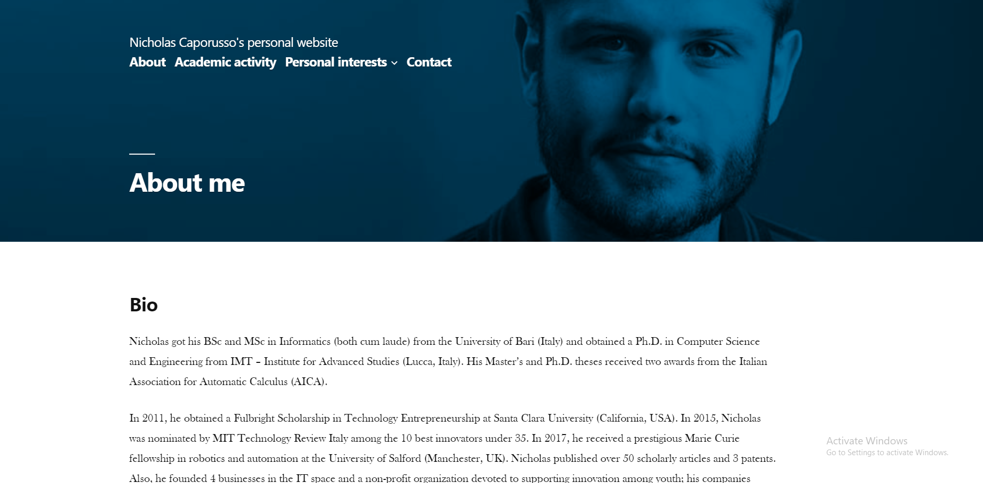
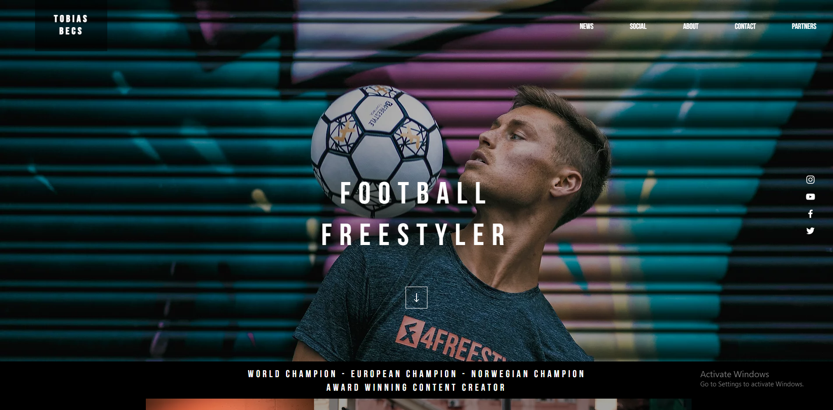
Similar Websites 1 of 2
Nicholas Caporusso's personal website (https://www.nicholascaporusso.com/)
Tobias Becs (https://www.tobiasbecs.com/)

Slide 6
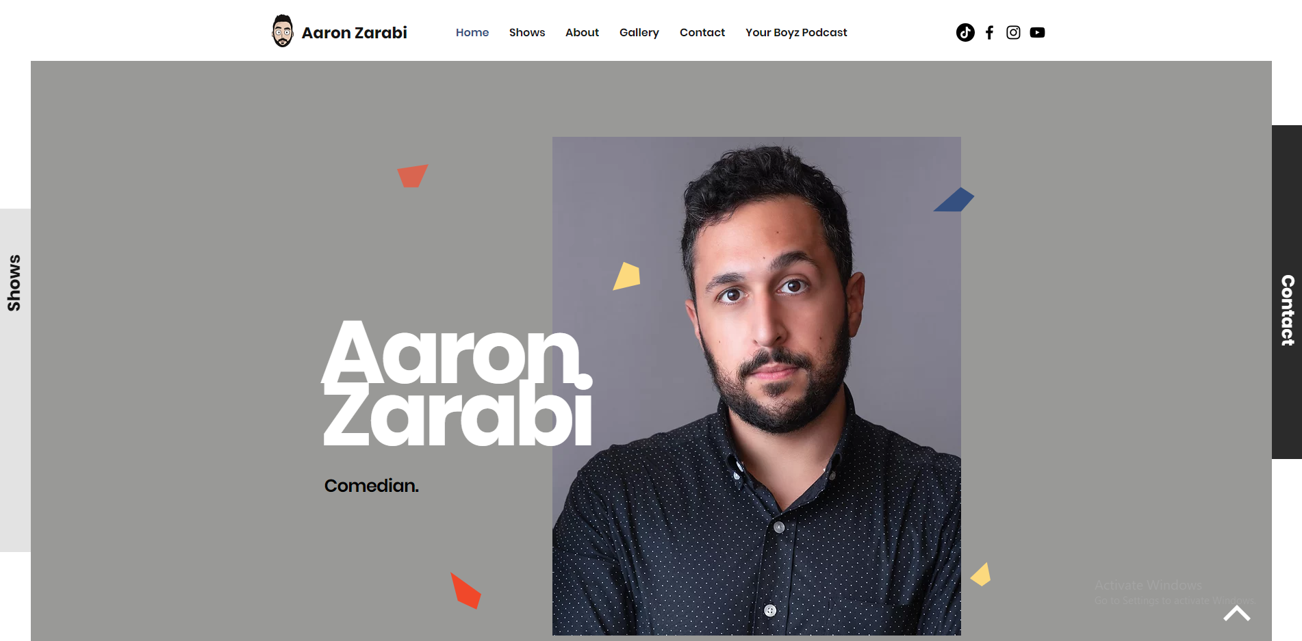
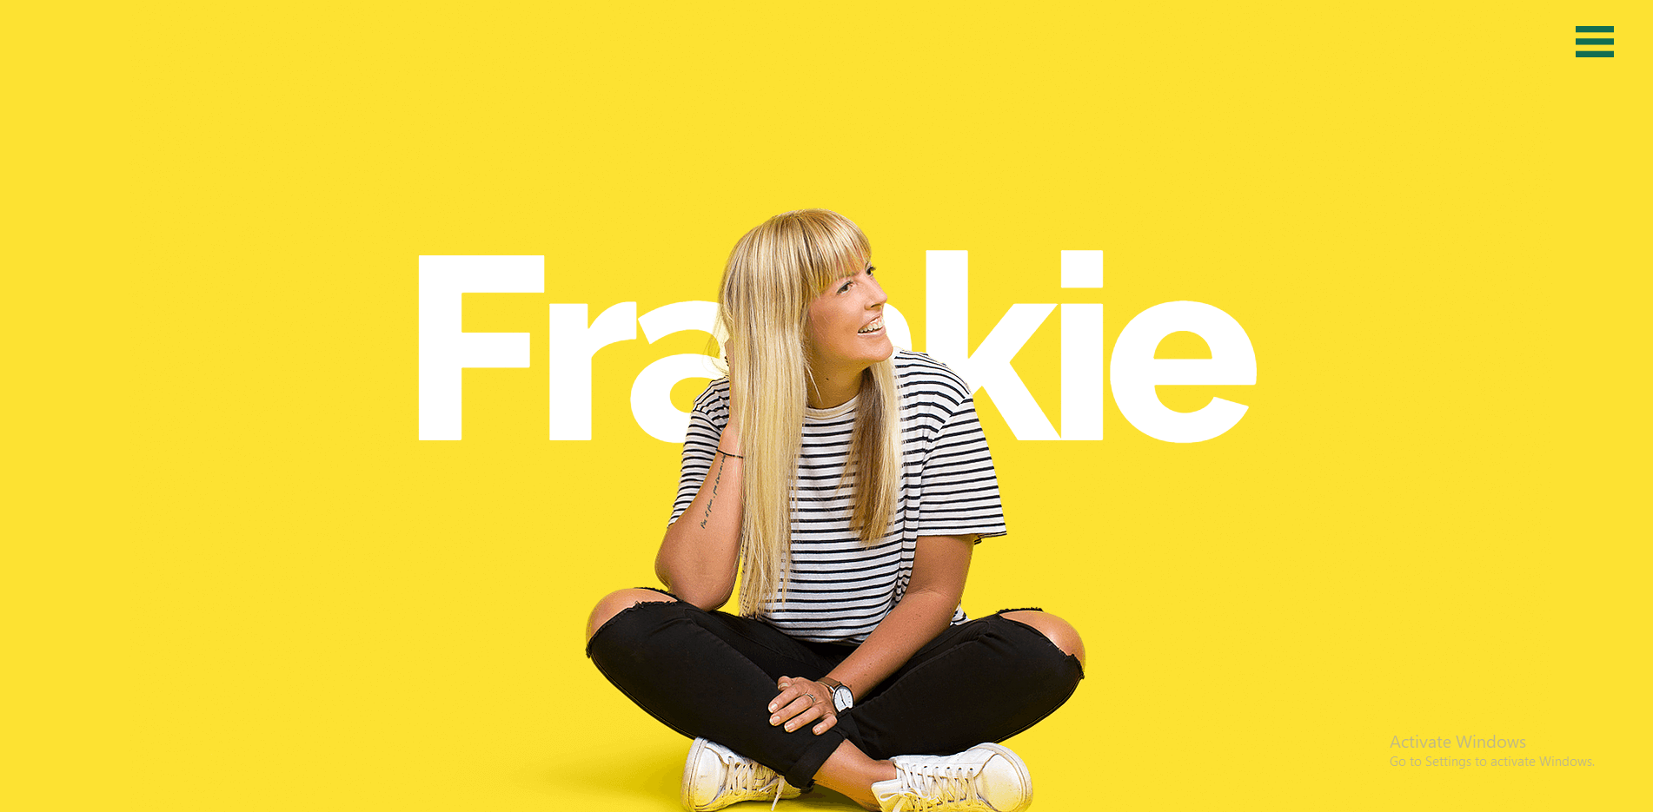
Similar Websites 2 of 2
Aaron Zarabi (https://www.aaronzarabi.com/)
Frankie Ratford (https://www.frankieratford.com/)

Slide 7
Color and Font Palette
Color
They both complement each other and give a sense of warmth and welcoming that will lighten them up when coming to the website
Font
I am using “Varela Round” because it vary smooth and gives a young but serious feel
#54627B
#ECD5BB
Varela Round

Slide 8
Website Hierarchy
Welcome Page
About Me
Hobbies
Future Ambitions
Projects
Contact Me

